Slide 1
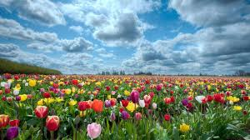
Welcome

Slide 2
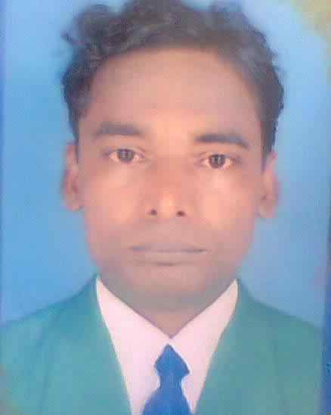
Introduction
Komal Kanta Ray TalukderMA,BEd
Assistant Teacher In English,
L.P.High School,
Chhatak,Sunamgonj
Mobile : 01714-529249

Slide 3
Introduction To Lesson And Class
Class : 8
Unit : 6
Lesson : 1
Topic : Our Folk Songs
Number of Students : 50
Time : 50 Minutes

Slide 4
Lesson Plan
S N | Stage | Activities | Time | Teaching Aids
1 | Preparation | Greeting + Catch Attention + Demonstration + Declaration Of Lesson | 5 M. | D.C
2 | Learning Outcome-1 | Brief Discussion + Vocabulary [Group Work] | 12 | D.C
3 | Learning Outcome-2 | Question [Pair Work] | 8 | D.C
4 | Learning Outcome-3 | Summarize [Group Work] | 10 | D.C
5 | Evaluation | Questions | 10 | D.C
6 | Home Work | Paragraph | 3 | D.C
7 | Thanks |  | 2 | D.C

Slide 5
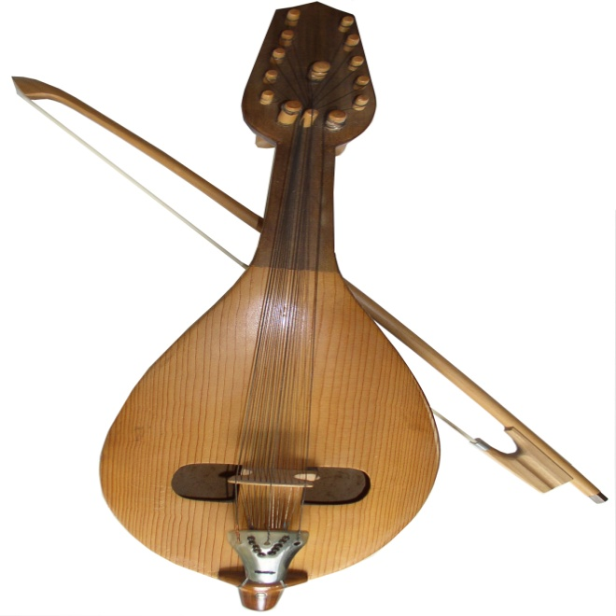
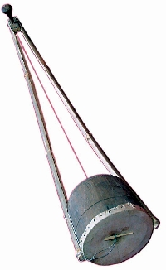
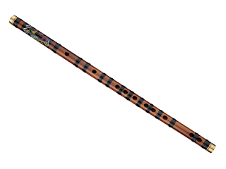
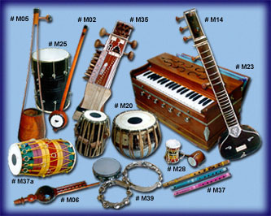
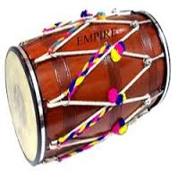
Previous Knowledge Test

Slide 6
Declaration of Lesson
Our Folk songs

Slide 7
Learning Outcome
By the end of the lesson learners . . .
1.Will be able to describe the meaning of new words
2. Mention our folk songs
3.Summarize the lesson

Slide 8
Vocabulary [Group Work]
Specific group of people
Community
Long term habits
Traditional
Past story
History
Collection
Gathering
About people
Folk

Slide 9
Pair Work
1. What do you mean by Folk Songs?

Slide 10
Group Work
1. Write summary of the text in five sentences.

Slide 11
Evaluation
1.Who usually likes our folk songs ?
2.Can you name some well known folk singers ?
3. Look at the musical instruments in A above and say which instruments go well with the folk songs.
4. Discuss in groups whether the modern instruments like the guitar and the piano could be played with the folk songs.

Slide 12
Home Work
Writing a paragraph on programmes of folk songs on our TV channels

Slide 13
Thanks

